Slide 1

JPMorgan Chase & Co. Stock Market Analysis
Varun Jagadeesh
Atulya Sharma – 001306609
Sanyukta khanvilkar -001051131
Lei Tan 001050148

Slide 2

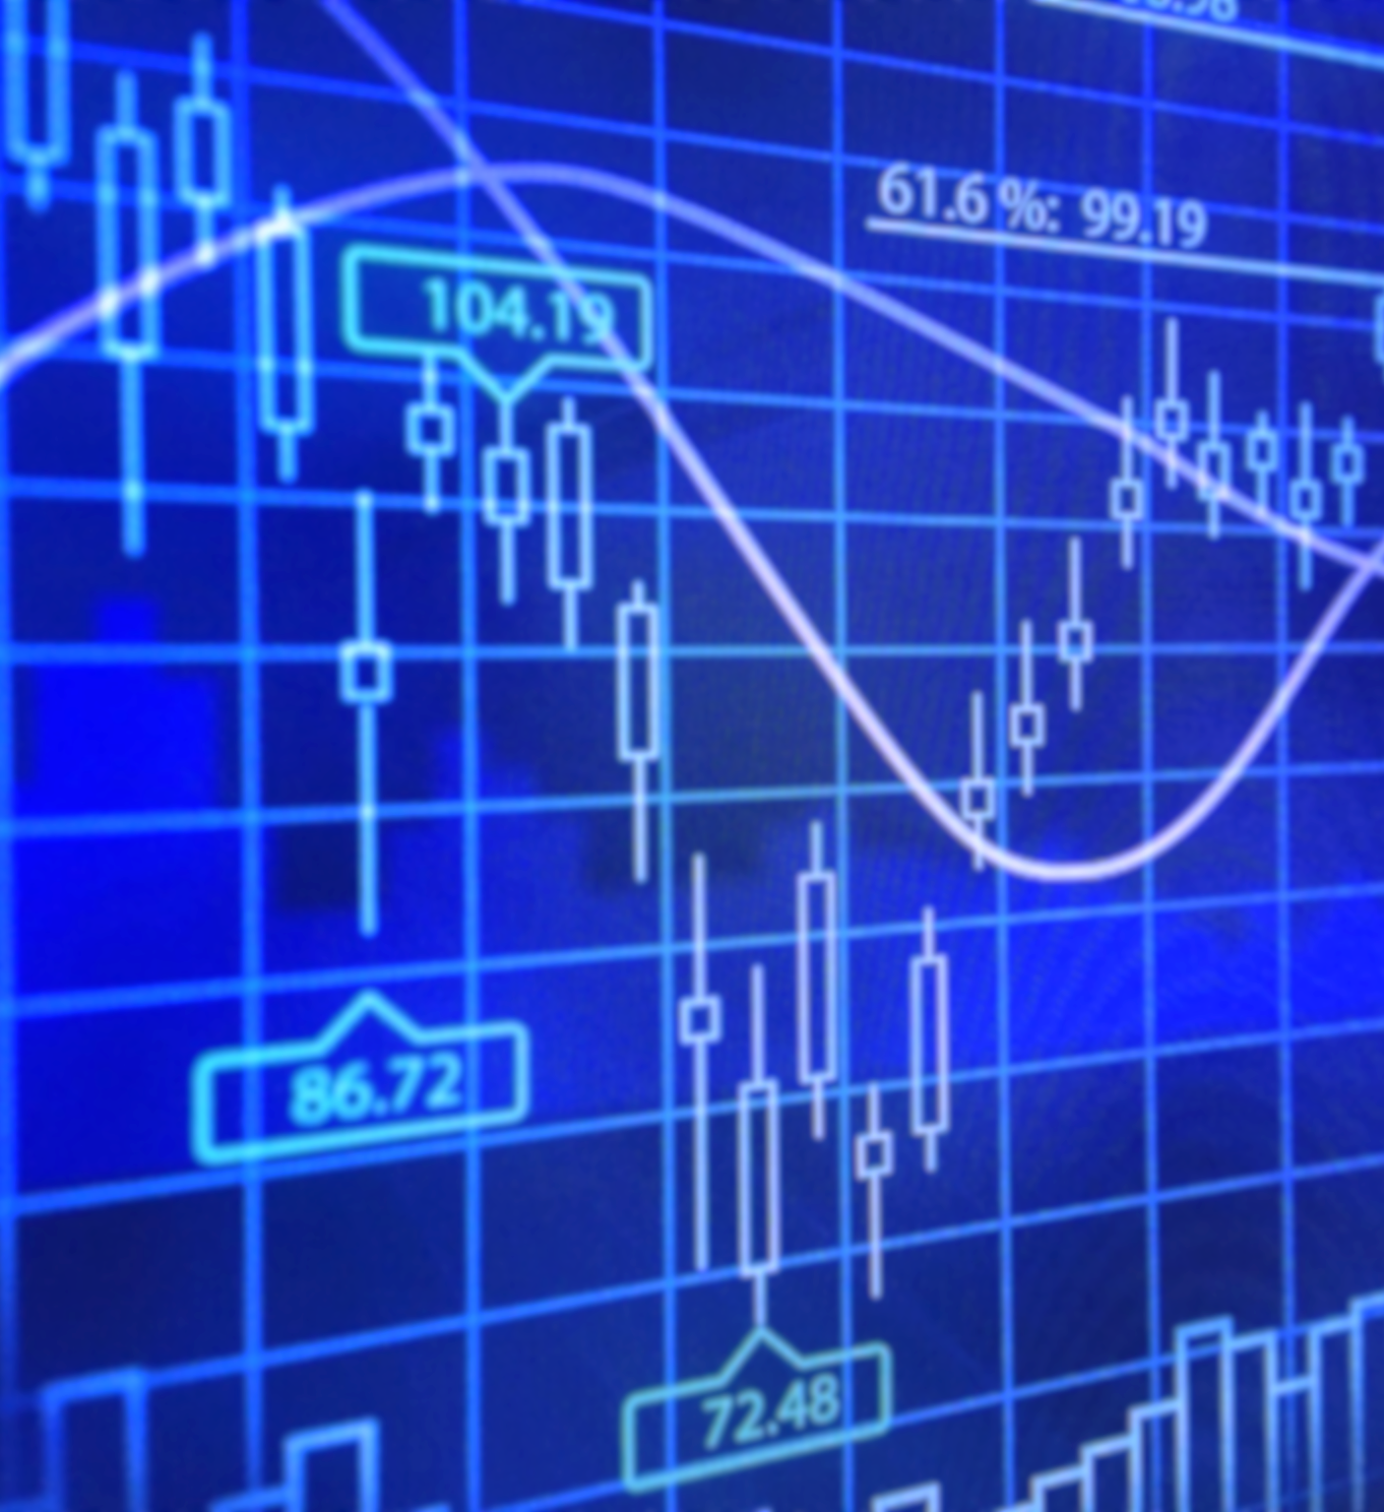
Contents
Background
Objectives
Data Processing Flow
Dataset
Exploratory Data Analysis
Models
Algorithm for Model Selection
Results
Trading Strategy
Future Scope and Failures
Sources

Slide 3


Background

Slide 4
background
JPMorgan Chase & Co is one of the oldest financial institutions in the world found in 1799 in New York City as "Bank of the Manhattan Company".
It has the largest market capitalization of any bank at $290 Billion.
JPM is also the sixth largest bank in the whole world with total assets close to $2.6 Trillion.
When JPM was available to trade in the New York Stock Exchange in 1980s, it started at a price close to $6 in 2020, the Stock price fluctuates around the $100 mark.
The company has been a part of numerous controversies which led to the company paying millions in settlement.
These controversies also lead to the stock prices fluctuating thus making it an ideal choice for studying.
JPMorgan Chase & Co's biggest rivals are Goldman Sachs, Morgan Stanley, Wells Fargo and Bank Of America.

Slide 5

Objectives
To assess the price dynamics of JPM stock over the period of 4 years using visualizations
To study various candidate models and algorithms to get the Error Metrics (R-Squared and RMSE)
Develop a trading strategy to make JPM a valuable offering

Slide 6
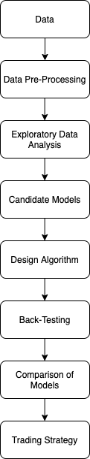
Data processing flow
Get the Data
Data Pre-Processing – Cleaning, Modification
Exploratory Data Analysis
Decide on the Candidate Models
Design an Algorithm
Back – testing
Comparison of models
Trading Strategy – buy or sell the stock at the right time

Slide 7
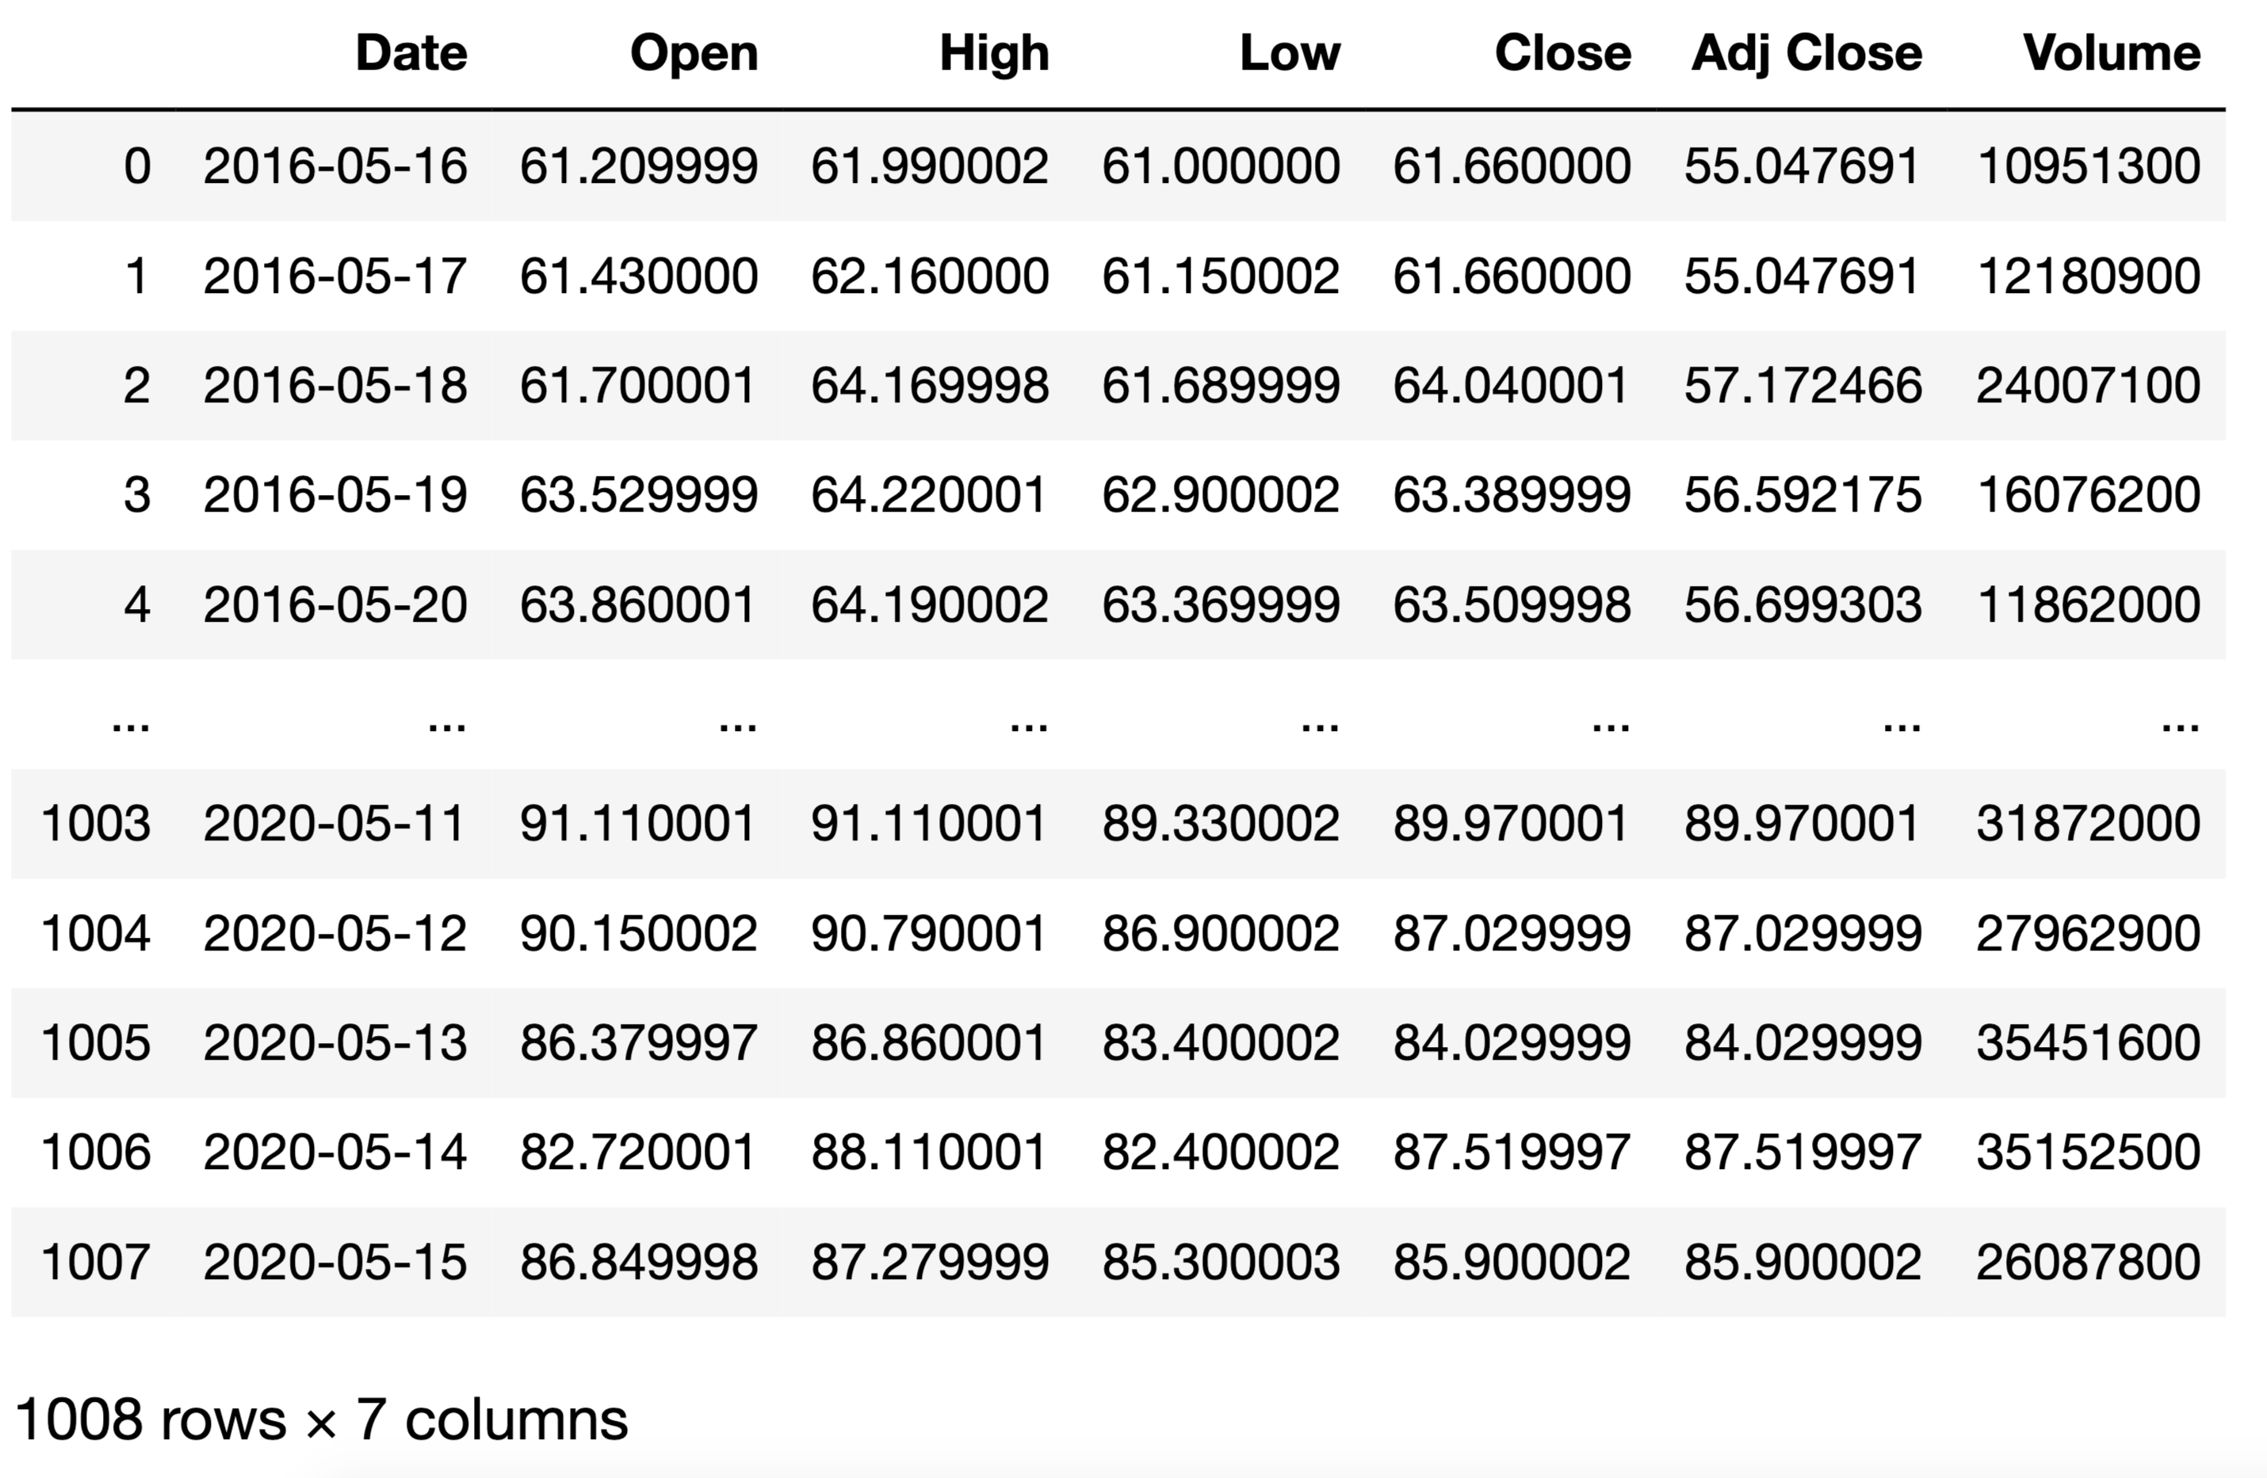
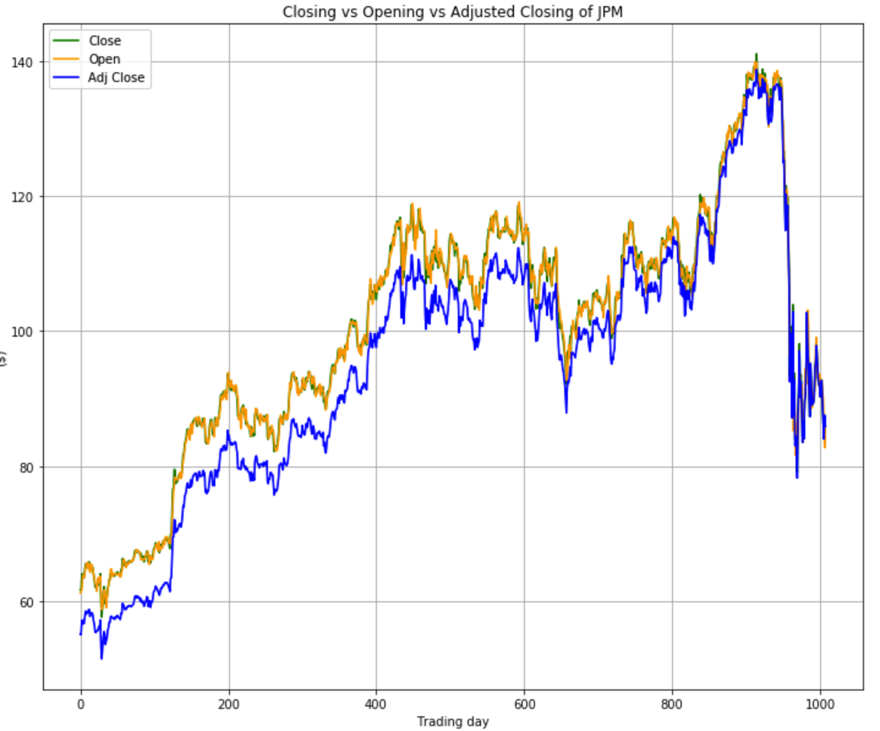
Dataset Description
The initial dataset has 1008 rows from 05/16/2016 to 05/20/2020. Following is the description of the columns:
Date: shows the date of the trading day.
Open: Opening price of JPM on that trading day.
High: Highest price of JPM on that trading day.
Low: Lowest price of JPM on that trading day.
Close: Closing price of JPM at the end of the trading day.
Adj Close: It is the closing price after adjustments for all applicable splits and dividend distributions.
Volume: The total number of shares traded on the trading day.
Apart from this Fama-French data has also been used.

Slide 8
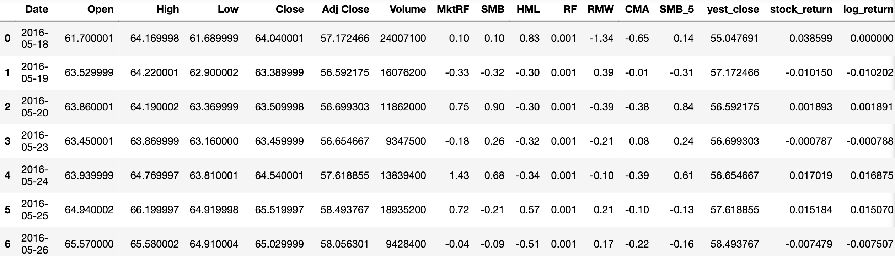
Data – Preprocessing
Following steps have been taken to use the data in the models and the algorithms:
The date range has been changed to have 997 rows down from 1008 rows
Columns from Fama – French 3 factor and 5 factor model have been added to the initial JPM dataset
New columns; yest_close, stock_return and log_return have been calculated and added to the dataset

Slide 9
Exploratory Data Analysis

Slide 10
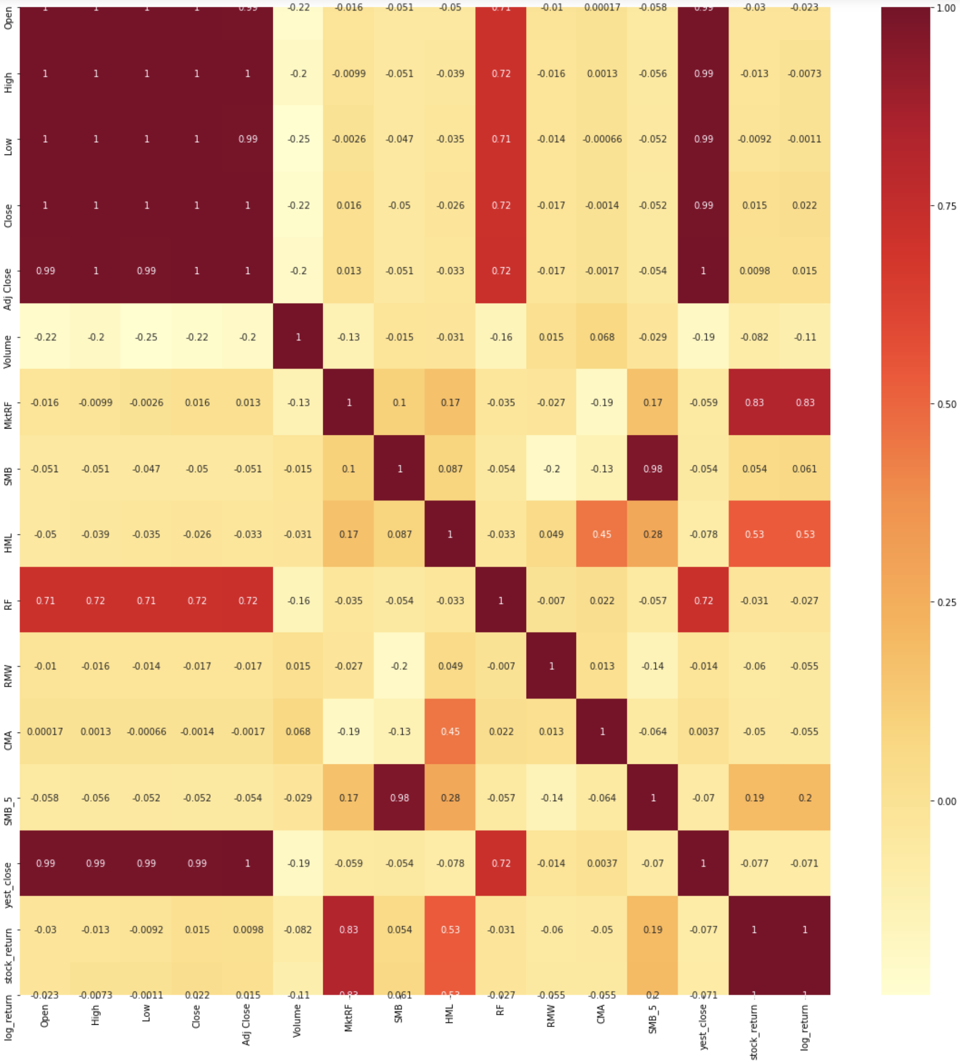
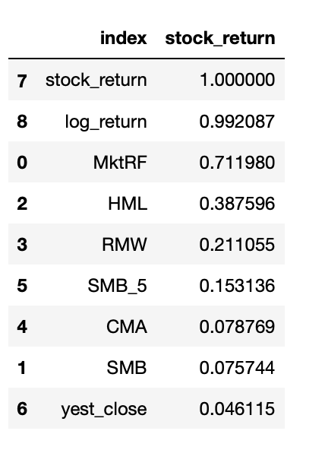
Heatmap showing relation between different features

Slide 11
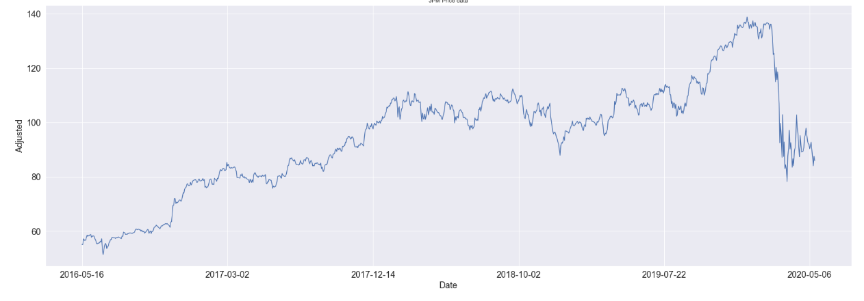
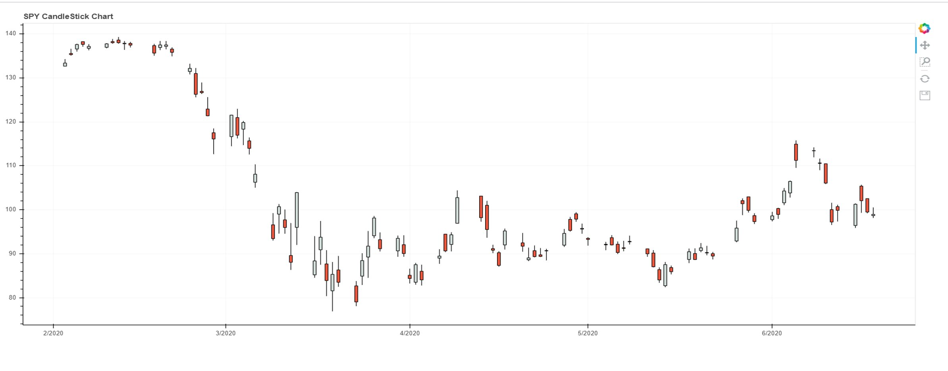
JPM closing PRICE Data
JPM: Closing Price
JPM: Closing Price Down & Up Days

Slide 12
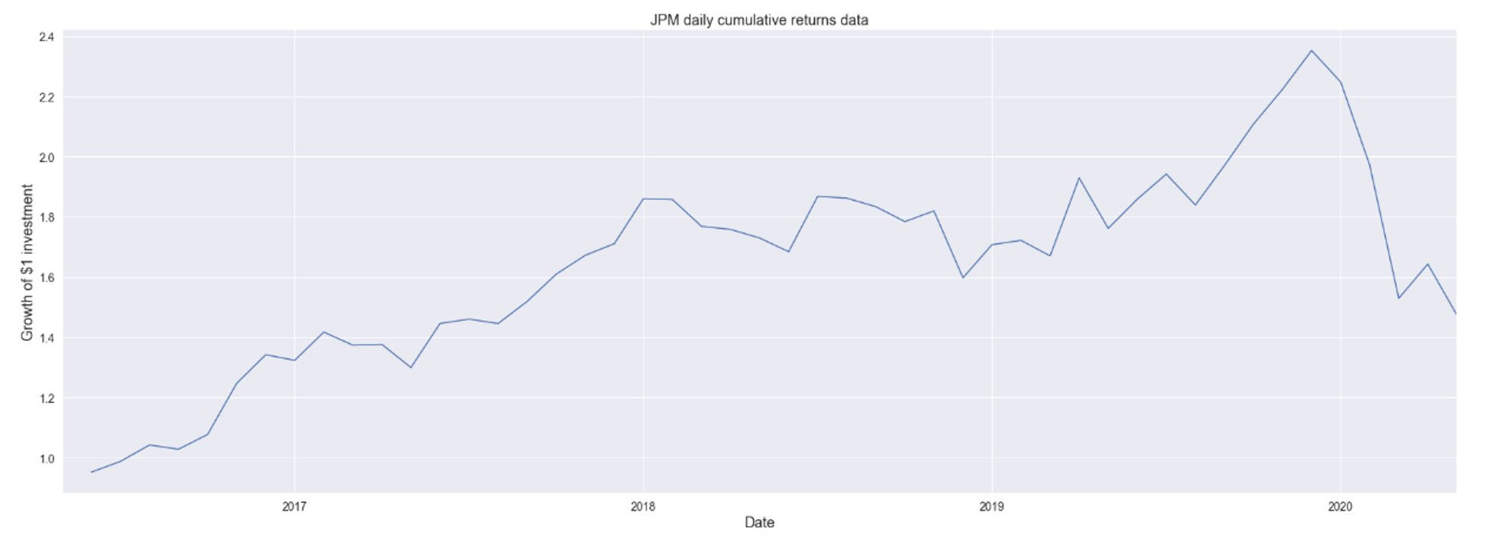
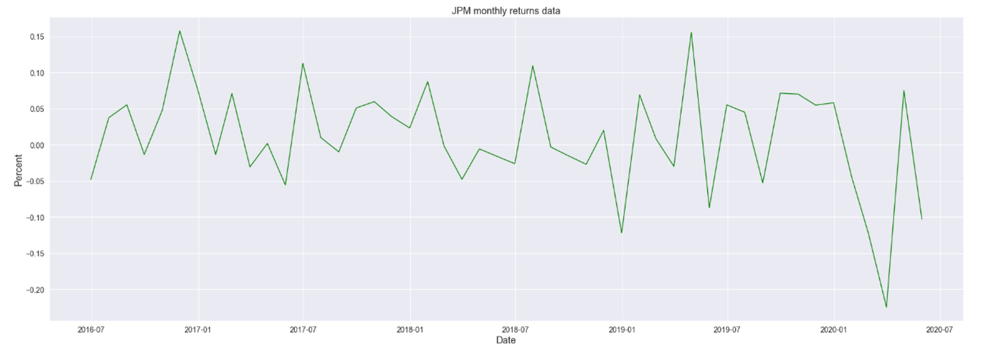
JPM Daily AND Monthly Cumulative RETURNS DATA

Slide 13
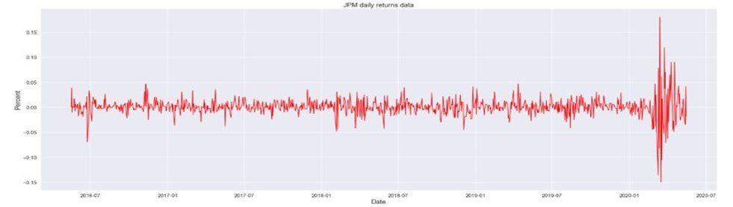
JPM DAILY RETURNS DATA

Slide 14
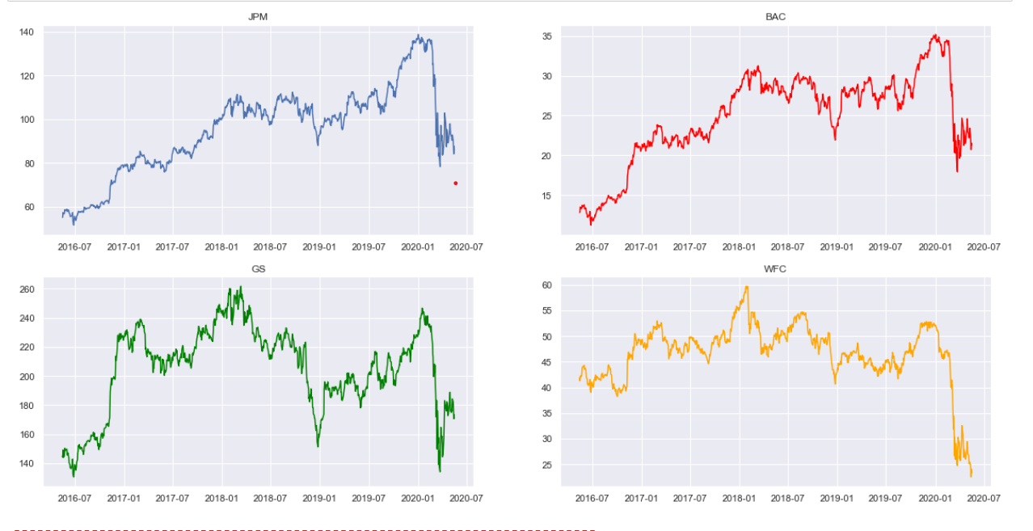
CLOSING PRICE COMPARISON OF STOCKS
The graphs show the fluctuation in the closing price of JPM, WFC, GS and BAC. We find that JPM isn't as volatile as the other stocks, but it still has an upward curve showing that investing in JPM will get positive outcomes.

Slide 15
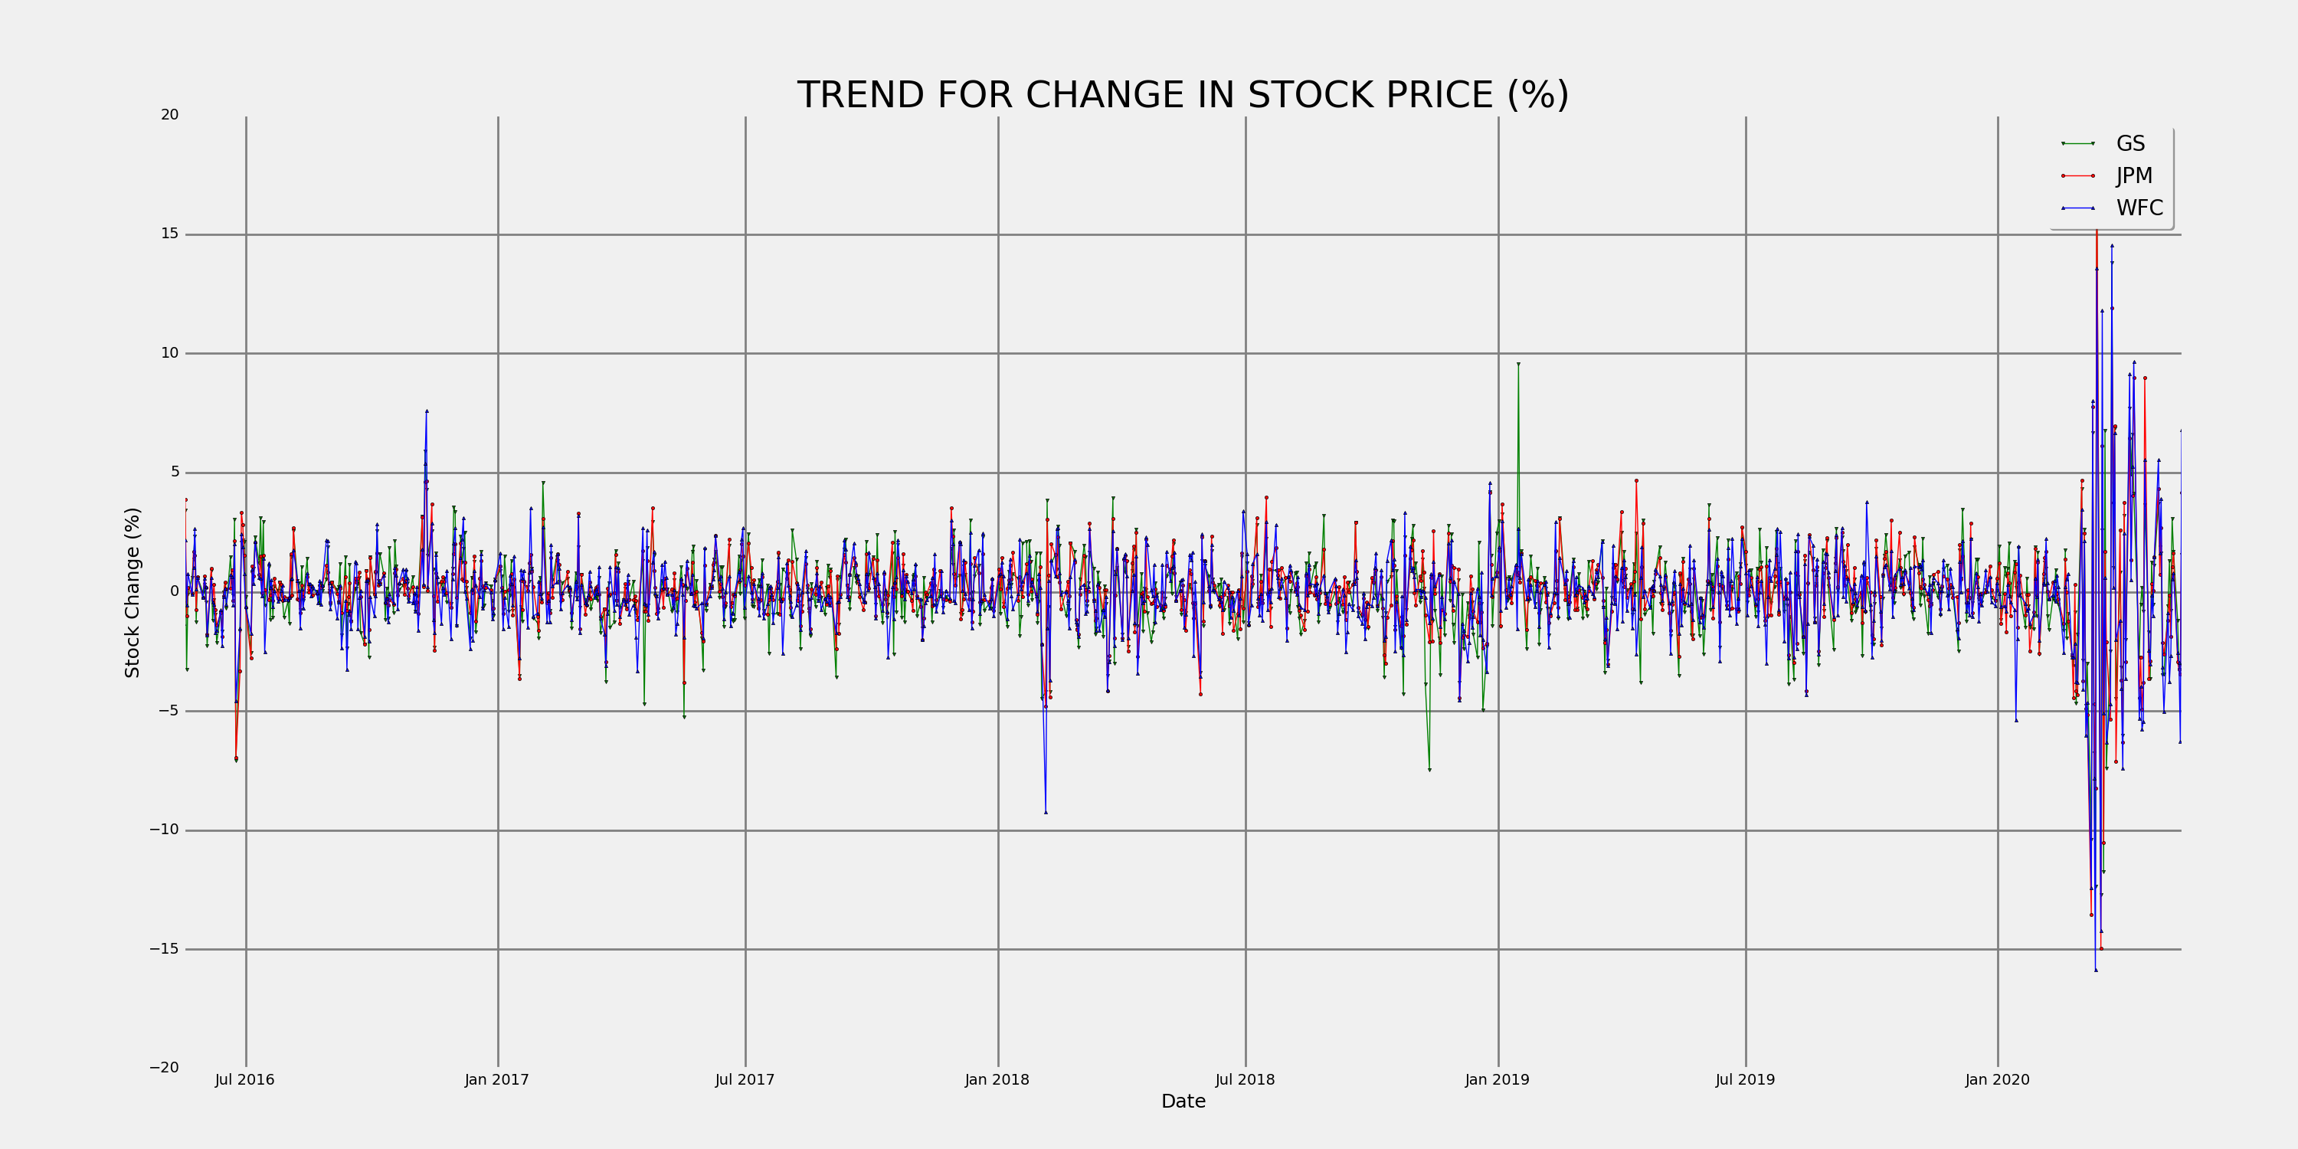
Comparison: Based on change in stock price

Slide 16
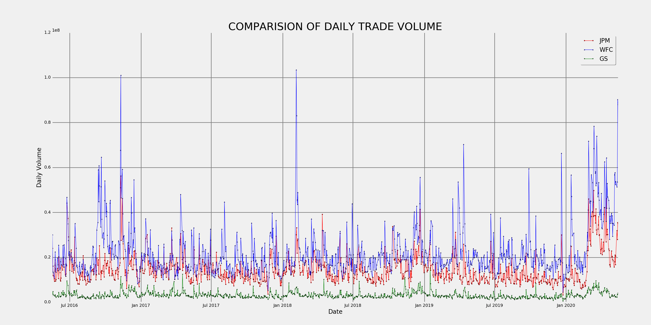
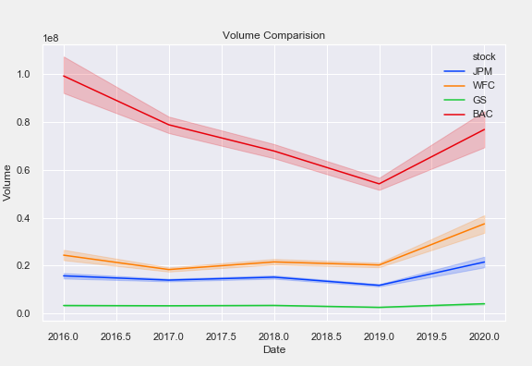
Comparision: Based on daily trade volume
Daily trade volume is said to indicate that the upward or downward trend in the price of the stock. If the daily trade volume increases, the price of the stock also increases.
From the graphs above, JPM does not have as steep of a curve when compared to WFC and BAC, indicating that the prices neither increase not decrease as much as the other ones. But it is not as constant as GS which does not show a very promising future.

Slide 17
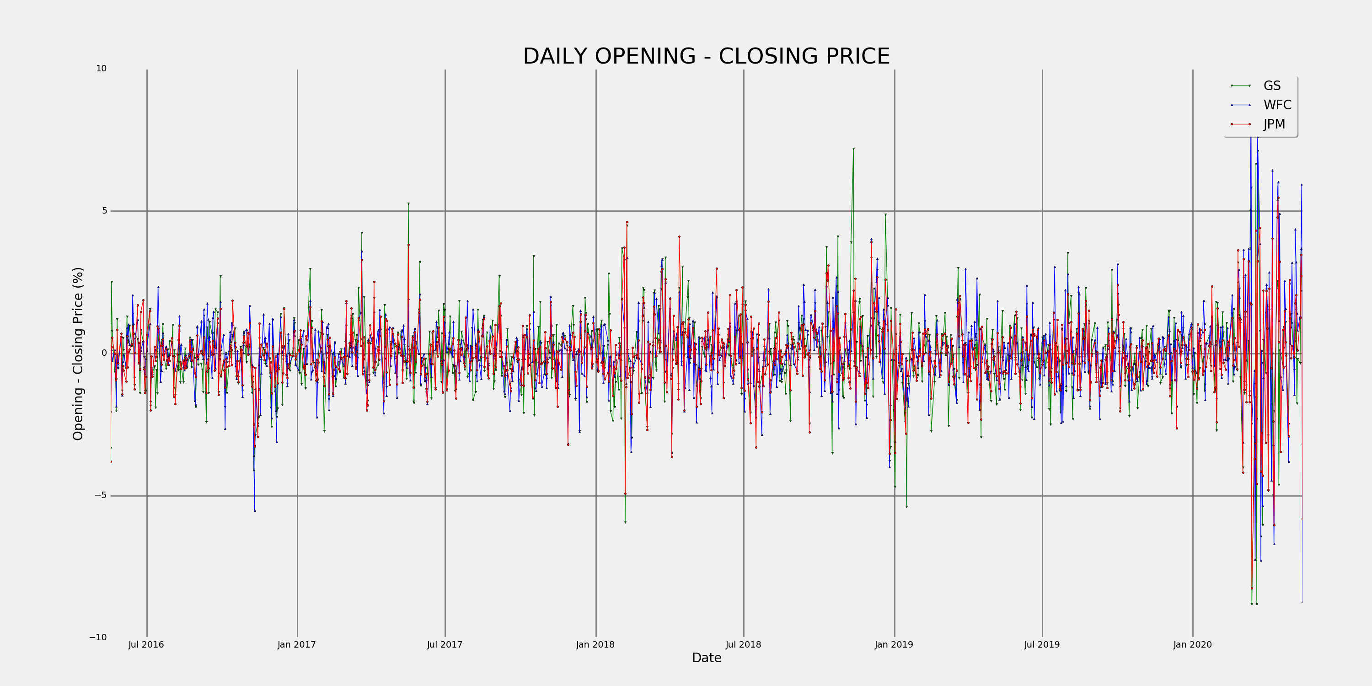
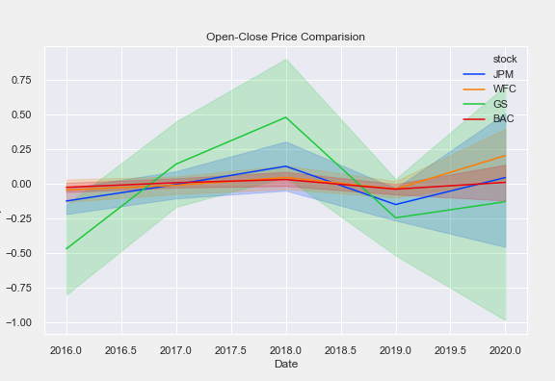
Comparision: Based on Opening – CLosing Price
Looking at the Opening - Closing price, we see that GS is the most fluctuating. In 2016, the difference was the highest in the negative side and in 2018, the difference was the highest in the positive, deeming it the most inconsistent of all the other stocks.
WFC and BAC have the most consistent but the least rewarding difference which points out that daily traders won't benefit from them as much.
JPM strikes the perfect balance making it a safe and a rewarding option.

Slide 18
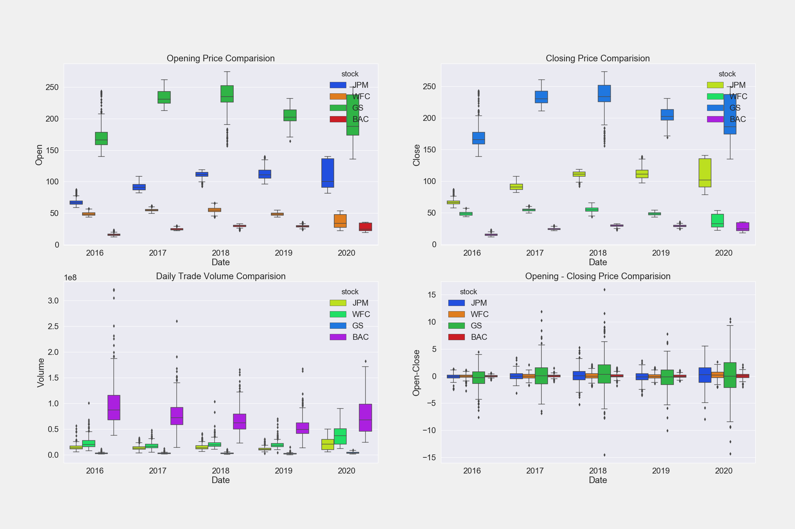
Comparision: Boxplot

Slide 19
Model selection

Slide 20

Models
Candidate Models
GARCH
Kalman Filter
ARIMA
CAPM
Fama French 3 Factors
Fama French 5 Factors
Machine Learning Models
Random Forest
Support Vector Machines (SVM)

Slide 21
Garch
The generalized autoregressive conditional heteroskedasticity (GARCH) process is an econometric term developed in 1982 by Robert F. Engle, an economist and 2003 winner of the Nobel Memorial Prize for Economics, to describe an approach to estimate volatility in financial markets.
The general process for a GARCH model involves three steps. The first is to estimate a best-fitting autoregressive model. The second is to compute autocorrelations of the error term. The third step is to test for significance.
An ARCH (AutoRegressive Conditionally Heteroskedasticity) model is a model for the variance of a time series. ARCH models are used to describe a changing, possibly volatile variance.
If an Autoregressive Moving Average (ARMA) model is used for error variance, the model is a Generalized AutoRegressive Conditionally Heteroskedasticity (GARCH) model.
r_{t} = µ + σ_{t}ε_{t}
Where ε_{t} is the standard normal and is the σ_{t} variance.

Slide 22
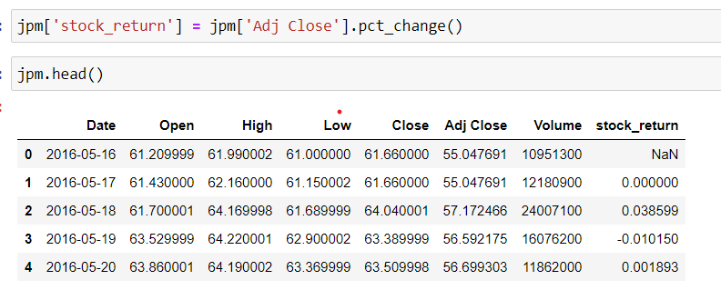
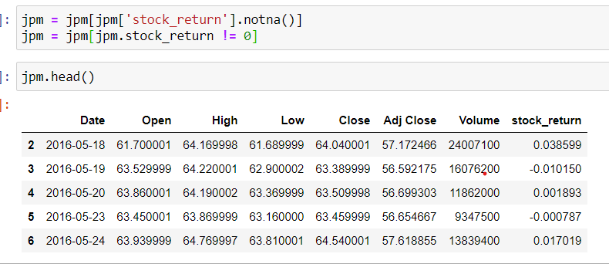

Slide 23
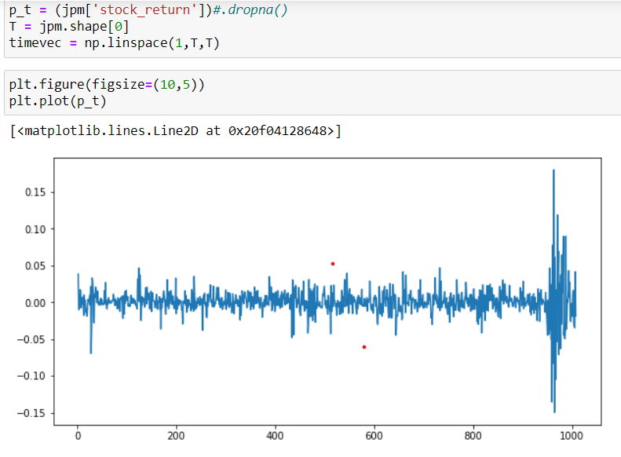
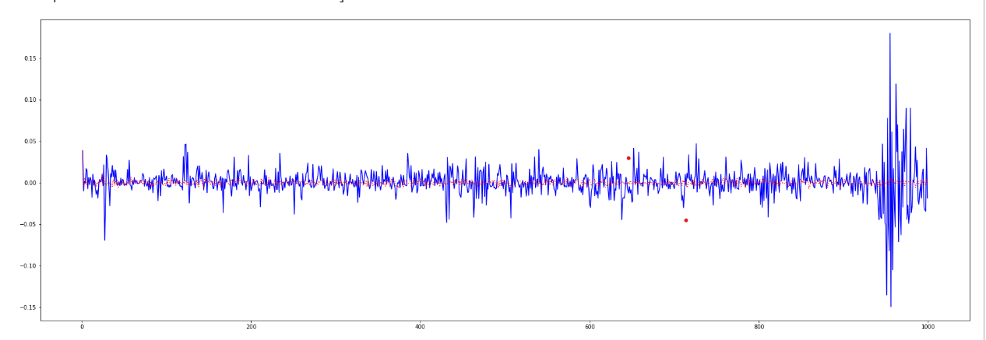
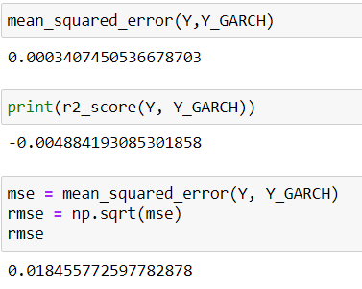
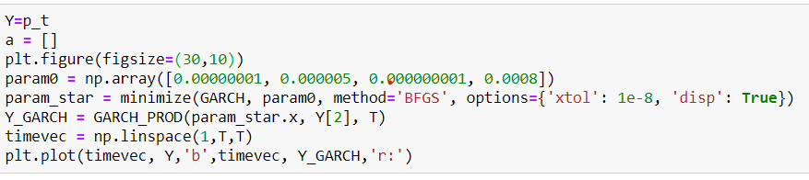

Slide 24
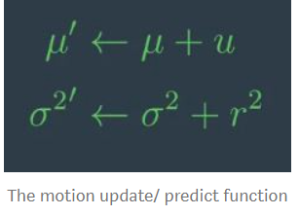
Kalman Filter
The Kalman filter is a set of mathematical equations that provides an efficient computational (recursive) means to estimate the state of a process, in a way that minimizes the mean of the squared error. The filter is very powerful in several aspects: it supports estimations of past, present, and even future states, and it can do so even when the precise nature of the modeled system is unknown.
In Kalman filters, we iterate measurement(measurement update) and motion (prediction). And the update will use Bayes rule, which is nothing else but a product or a multiplication. In prediction, we use total probability which is a convolution or simply an addition.

Slide 26
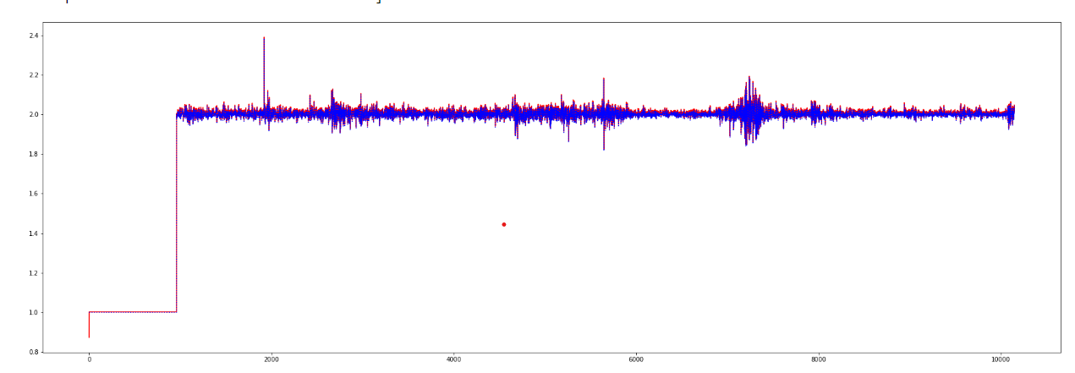
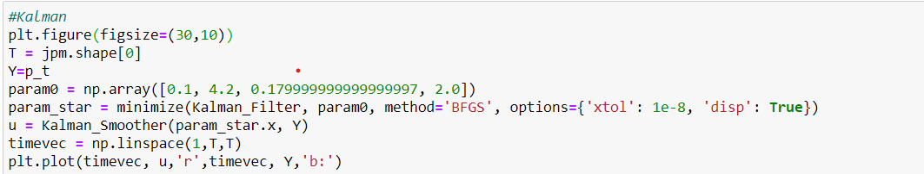
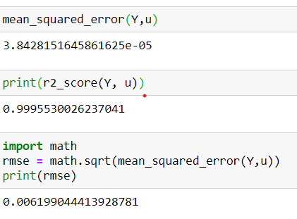

Slide 27
CAPM
Description
The Capital Asset Pricing Model (CAPM) describes the relationship between systematic risk and expected return for assets, particularly stocks. CAPM is widely used throughout finance for pricing risky securities and generating expected returns for assets given the risk of those assets and cost of capital.
Formulae
ERi =Rf +βi (ERm −Rf )
where: ERi =expected return of investment
Rf =risk-free rate
βi =beta of the investment
(ERm −Rf )=market risk premium

Slide 28
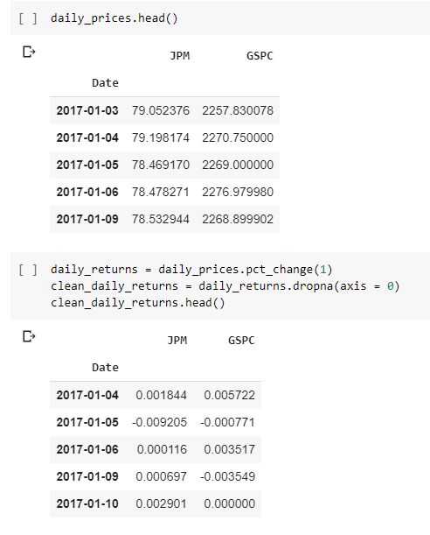
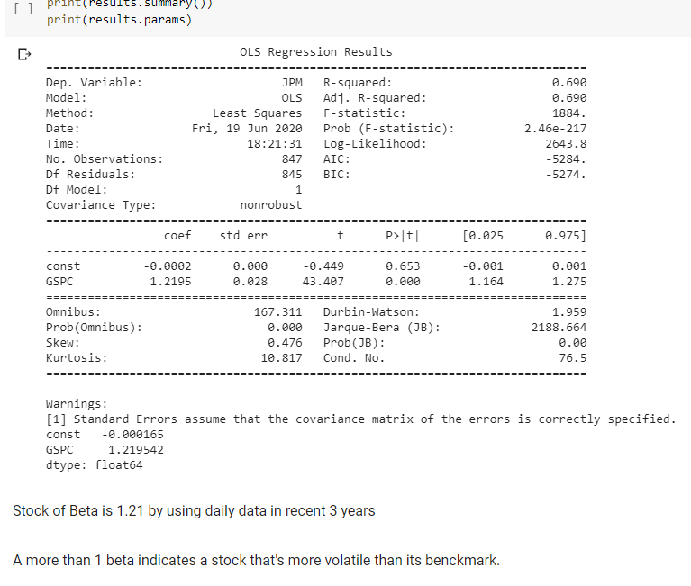
The beta is a measure of a stock’s risk (volatility of returns) reflected by measuring the fluctuation of its price changes relative to the overall market. In other words, it is the stock’s sensitivity to market risk. For instance, if a company’s beta is equal to 1.5 the security has 150% of the volatility of the market average. However, if the beta is equal to 1, the expected return on a security is equal to the average market return. A beta of -1 means security has a perfect negative correlation with the market.

Slide 29
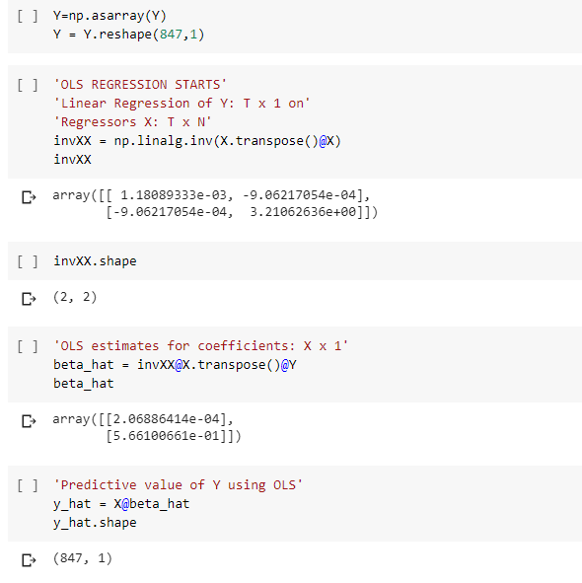
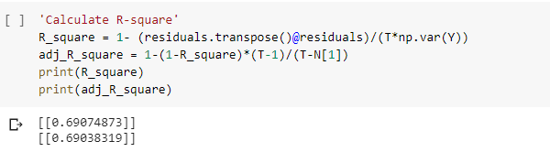
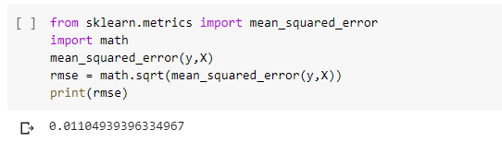
After this ,we will use the idea of random forest to get a precise beta.

Slide 30
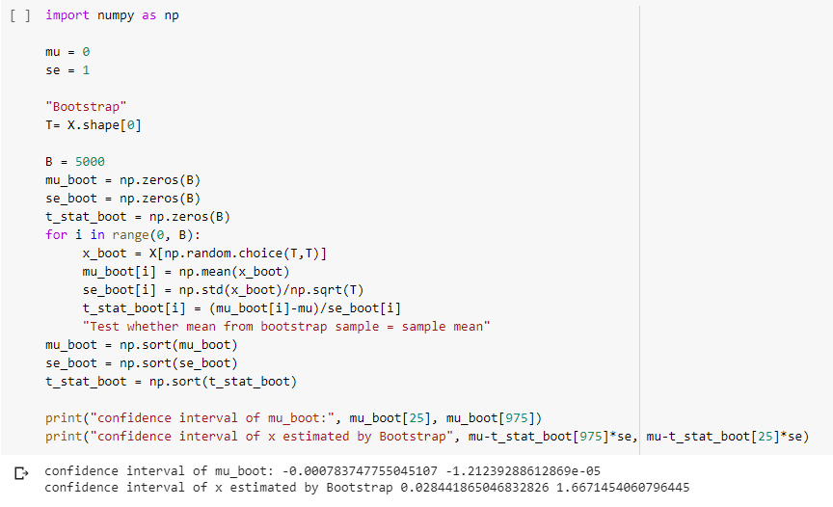
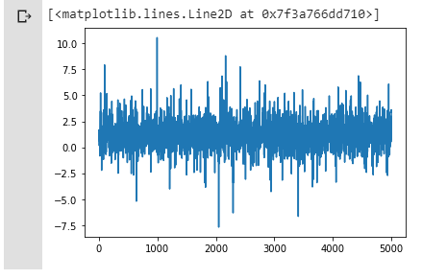
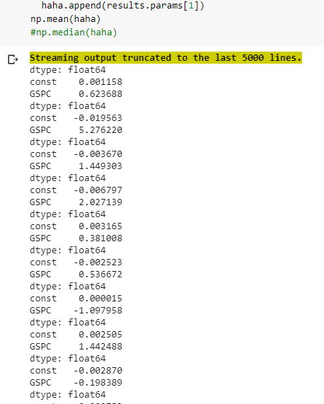
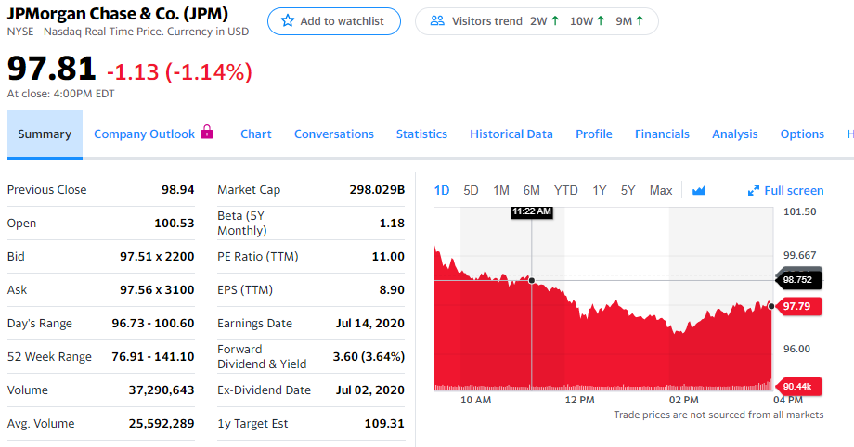
1.219542
1.1777480569069207

Slide 31
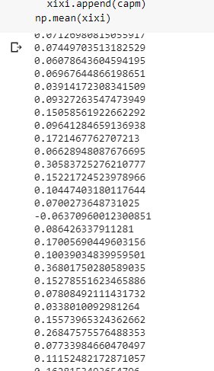
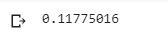

Slide 32
Arima
AutoRegressive Integrated Moving Average
An ARIMA model is a class of statistical models for analyzing and forecasting time series data
Parameters used to define model -
p : The number of lag observations included in the model, also called the lag order
d : The number of times that the raw observations are differenced, also called the degree of differencing
q : The size of the moving average window, also called the order of moving average.

Slide 33
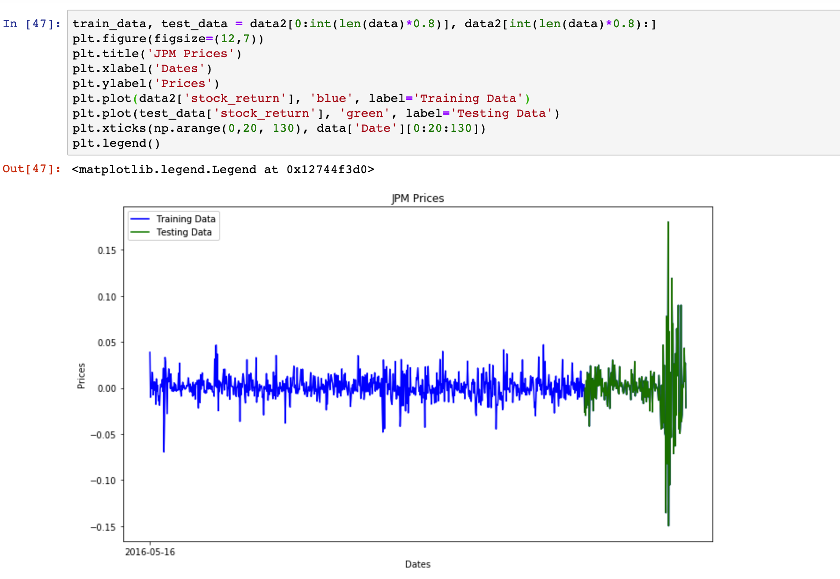
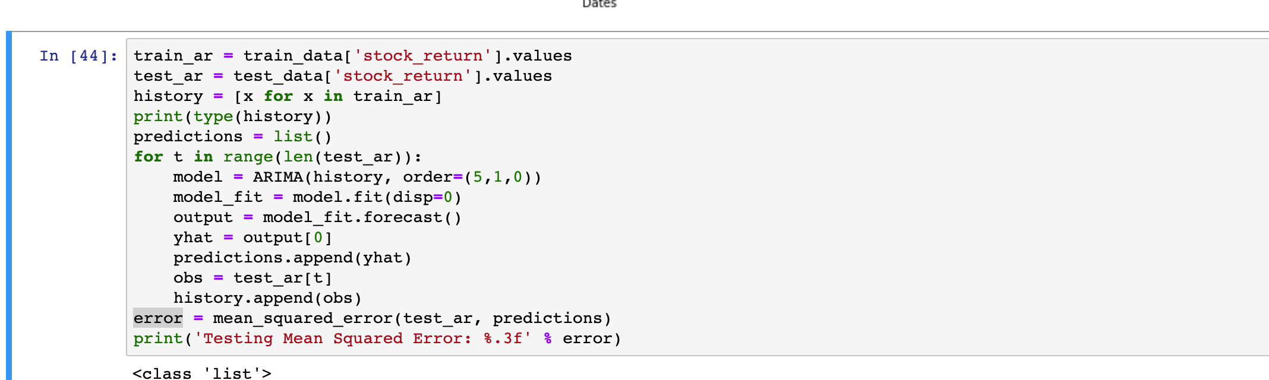
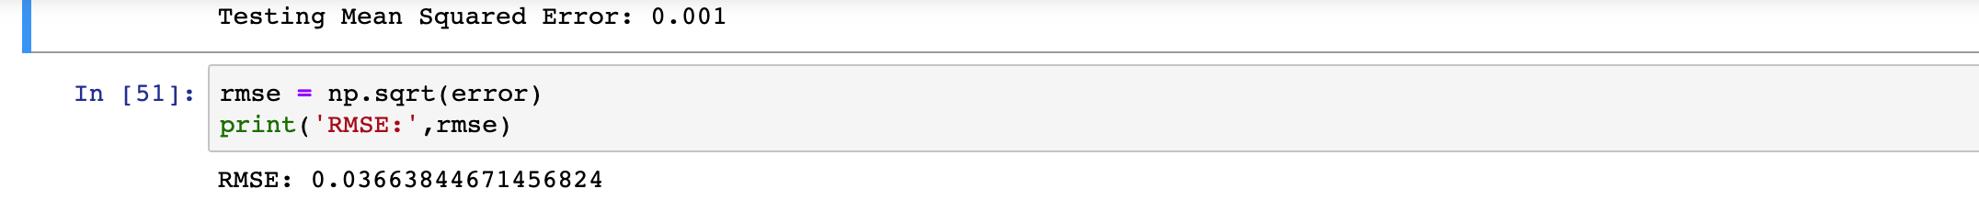

Slide 34
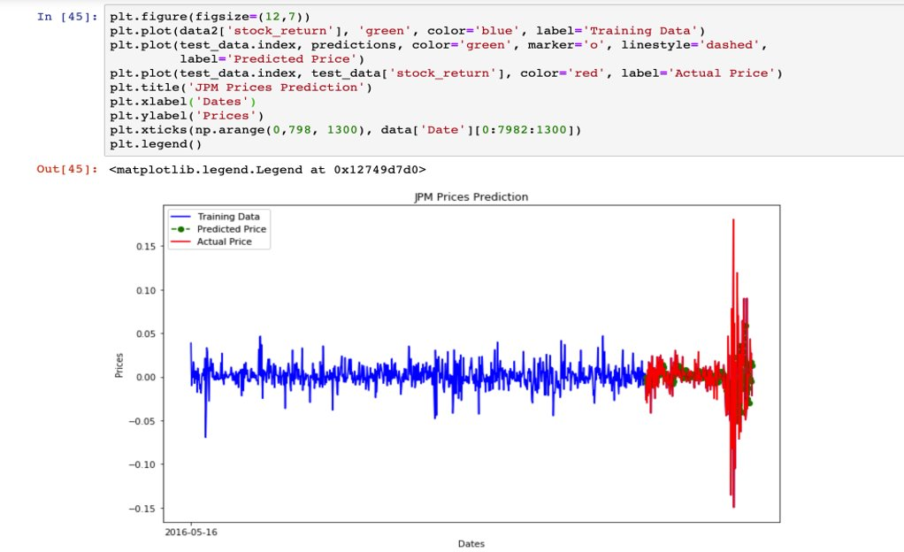
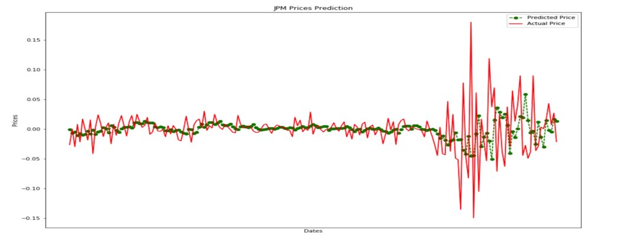

Slide 35
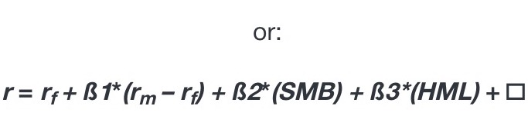
Fama French - 3 Factor
This model describes stock return. Before Fama – French, CAPM was widely used.
Fama – French has the following factors:
Market Risk Premium (r_{m} – r_{f})- It represents the difference between the expected return of the market and the risk-free return rate. It gives the investor, returns above the risk-free rate.
Small Minus Big Market Capitalization (SMB)- Represents historic excess of small-cap companies over large-cap companies. Higher returns are expected from small- cap companies, rather than large-cap companies.
High Minus Low Book- to - Market Ratio (HML) - it is used to evaluate profit margins, short term & long-term.
Rate of return = Risk-free Rate + Market Risk Premium + SMB + HML
Here, r = expected rate of return
r_{f} = risk free return rate
β 1, 2, 3 = Factor's coefficient
☐ = Risk

Slide 36
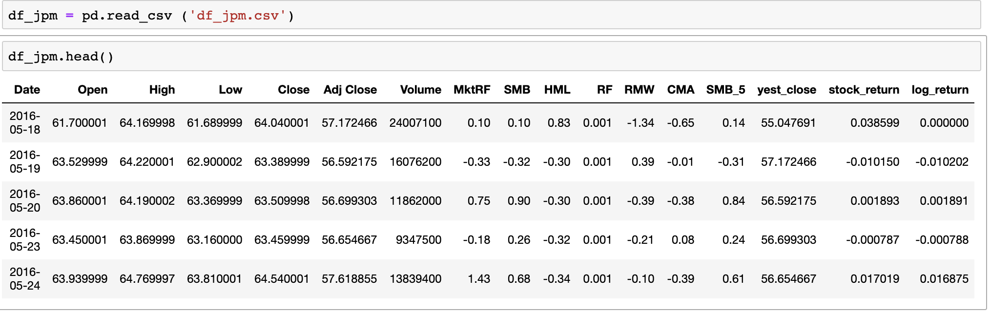
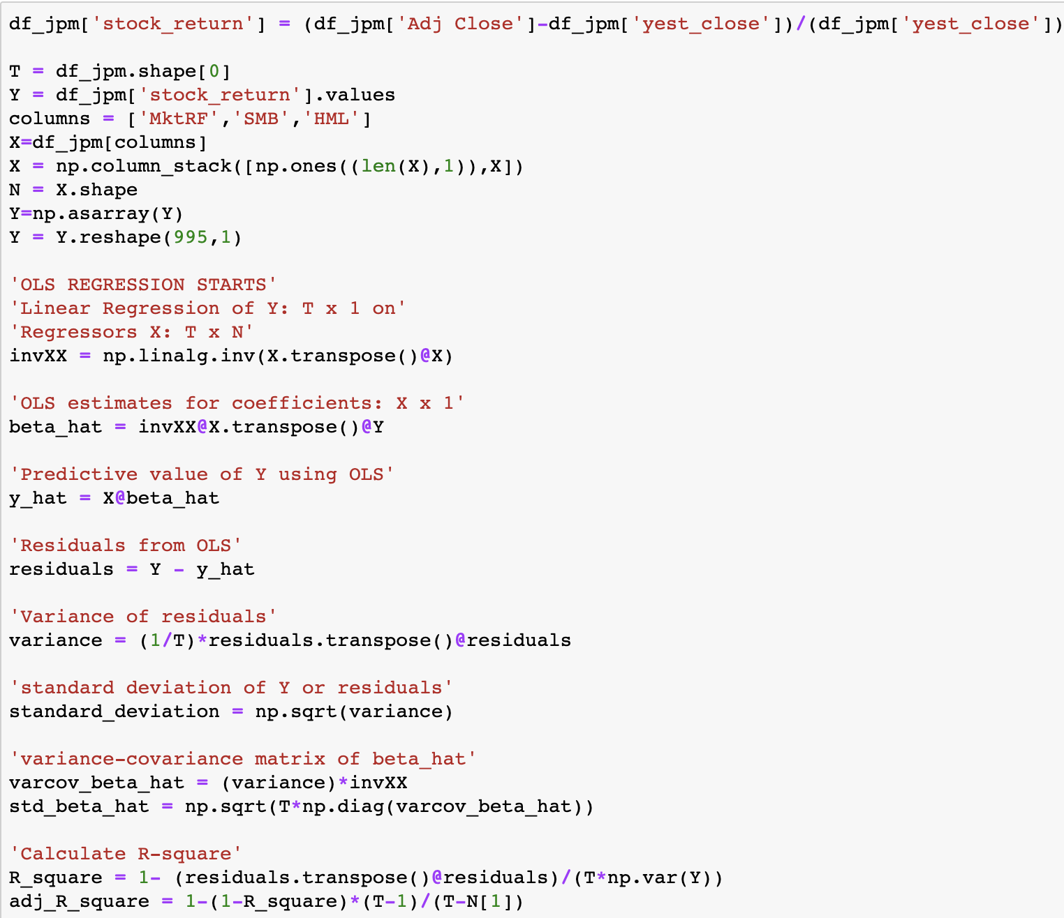
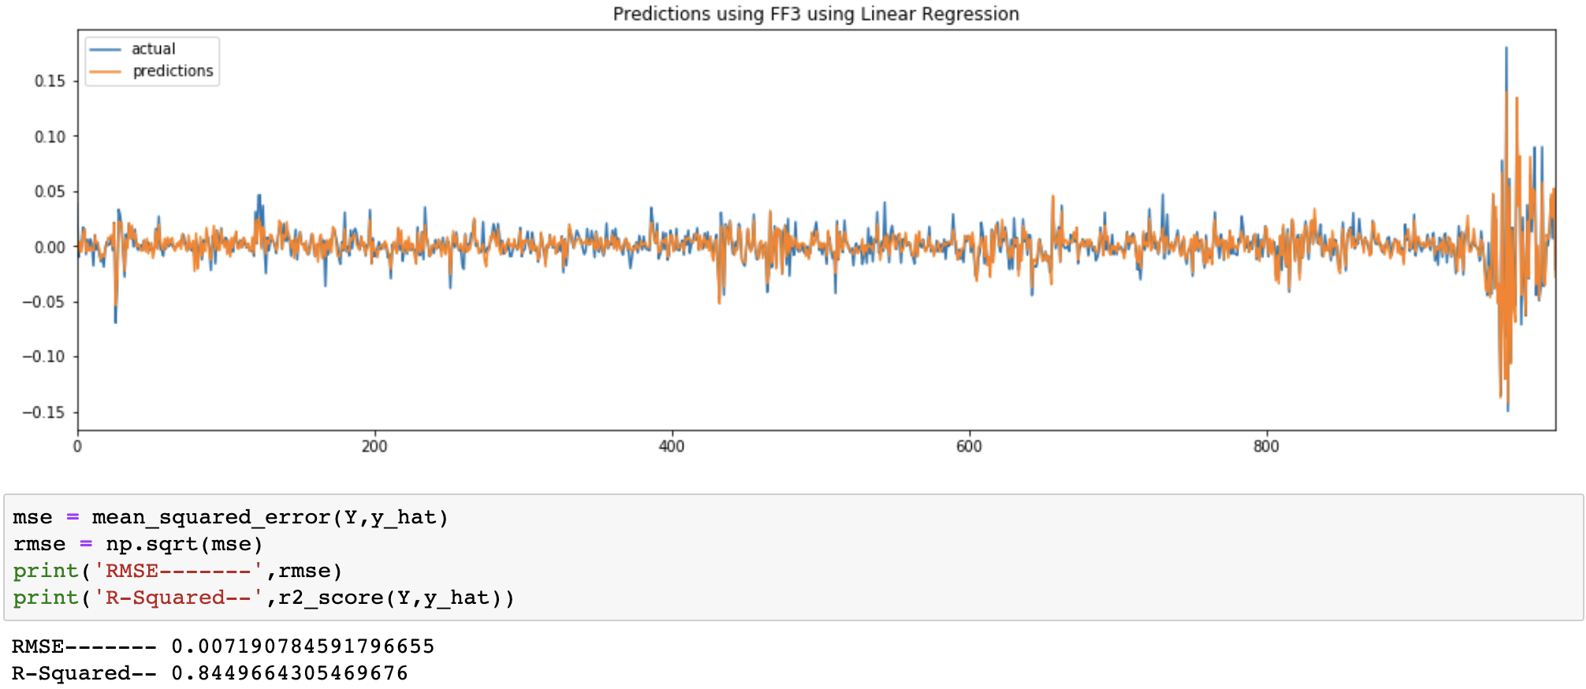
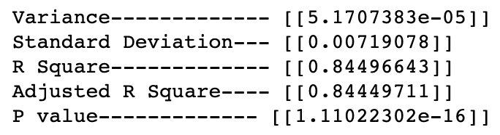

Slide 37
Fama French - 5 Factor
Fama – French 5 Factor is an extension of the 3 – Factor model with 2 extra factors:
Profitability (RMW) - Difference between the returns of the most profitable firms minus least profitable.
Investment(CMA) - Difference between returns of firms that invest conservatively and the firms that invest aggressively.

Slide 38





Slide 39

Random forest Algorithm
Best Candidate Models are:
Fama French – 3 Factors
Fama French – 5 Factors
SVM
Feature Selection using Lasso, and Heat Map
Algorithm
Set the window size to be 60
Bootstrap count was varied for each model as the training time was too much
Selected the dependent variable based on models and correlation map
Bootstrapped and created subsample for each day and predicted the target stock returns
Model which ever had values nearest to predicted values were chosen

Slide 40

Prediction using Random Forest

Slide 41
Results

Slide 42
Results
Candidate Models
Error Metric | GARCH | Kalman - Filter | CAPM | ARIMA | Fama French – 3 Factor | Fama French – 5 Factor
RMSE | 0.01845577 | 0.006199 | 0.01104939 | 0.03663 | 0.007 | 0.0067
R Squared | 0.00802615 | 0.995530 | 0.690 | 0.824 | 0.834 | 0.863
Supervised Machine Learning Model
SVM | RMSE = 0.01728
Random Forest
Random Forest | RMSE = 0.012

Slide 43

Trading Strategy - 1
model: Contains the stock return that we predicted having the train, test data
Predicted_stock_return_maximum - Max return a person can get upon selling the stock
Predicted_stock_return_minimum – Min return a person can get by selling the stock

Slide 44
Trading Strategy - 2
We create Simple Moving Averages (SMA) of a time series with differing lookback periods
Let’s say, 15 days and 60 days (short, long).
If the short moving average exceeds the long moving average then we go long and buy
If the long moving average exceeds the short moving average, then we don’t buy
Go long means it’s a BUY signal:
Stock price will go up and will sell at a higher price in the future
Go short means it’s a Sell Signal:
You sell the stock, expecting that you can buy it back at a lower price and realize a profit
Exit means don’t buy

Slide 45

Predicted close price
Close price was predicted using the stock return which we were able to predict using many models
Short and Long moving Avg was calculated with
Short window as 15
Long window as 60
Trading signal were generated

Slide 46

Buy, SELL
Green Marker – Buy the stock, price will go up
Red Marker – Sell the stock, price will go down

Slide 47

Sharp Ratio
Measures the performance of an investment compared to a risk-free asset, after adjusting for its risk
A ratio higher than 2.0 is rated as very good
Since the sharp ratio is good the profit the investors make is also really high

Slide 48
Conclusion
Deploy the model on cloud so that people can use the model to invest in the stock
Real time investment by buying no of shares and using the model to predict the return and we can determine how much profit or loss a person can get
Implement LSTM and compare with our models.

Slide 49
Sources
Yahoo Finance
JPMorganChase & Co
Wikipedia
Datacamp

Slide 50
Thank you

